Slide 1

Student Pass/Fail Prediction System
Submitted to : Prof. Abhishek Singh
Team member : Anshika Nigam
Pratha Solanki

Slide 2
AGENDA
Introduction and Project Objectives
Dataset Preparation
Data Preprocessing
Machine Learning Models in
Prediction Results
Conclusion and Future Enhancements

Slide 3
Problem Statement
Traditional methods cannot accurately predict student performance.
Challenges: Low attendance
Poor internal marks
Weak practical performance
Lack of data analysis

Slide 4
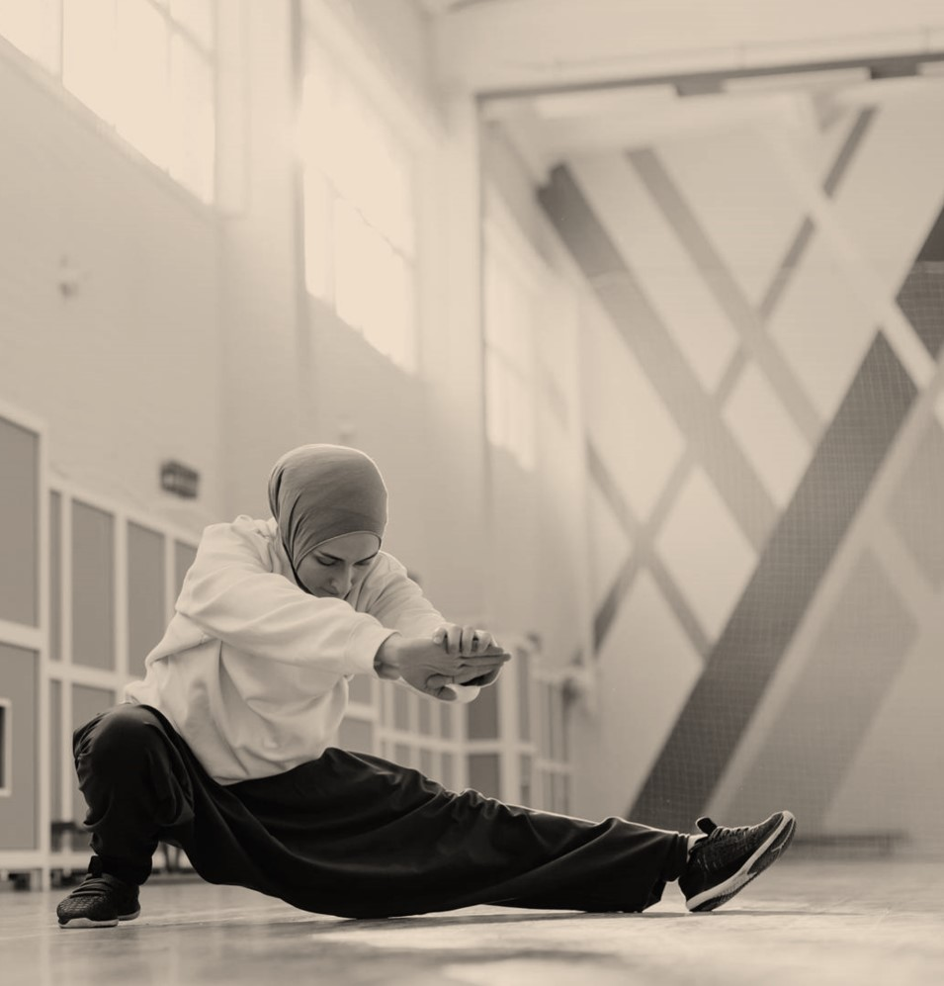
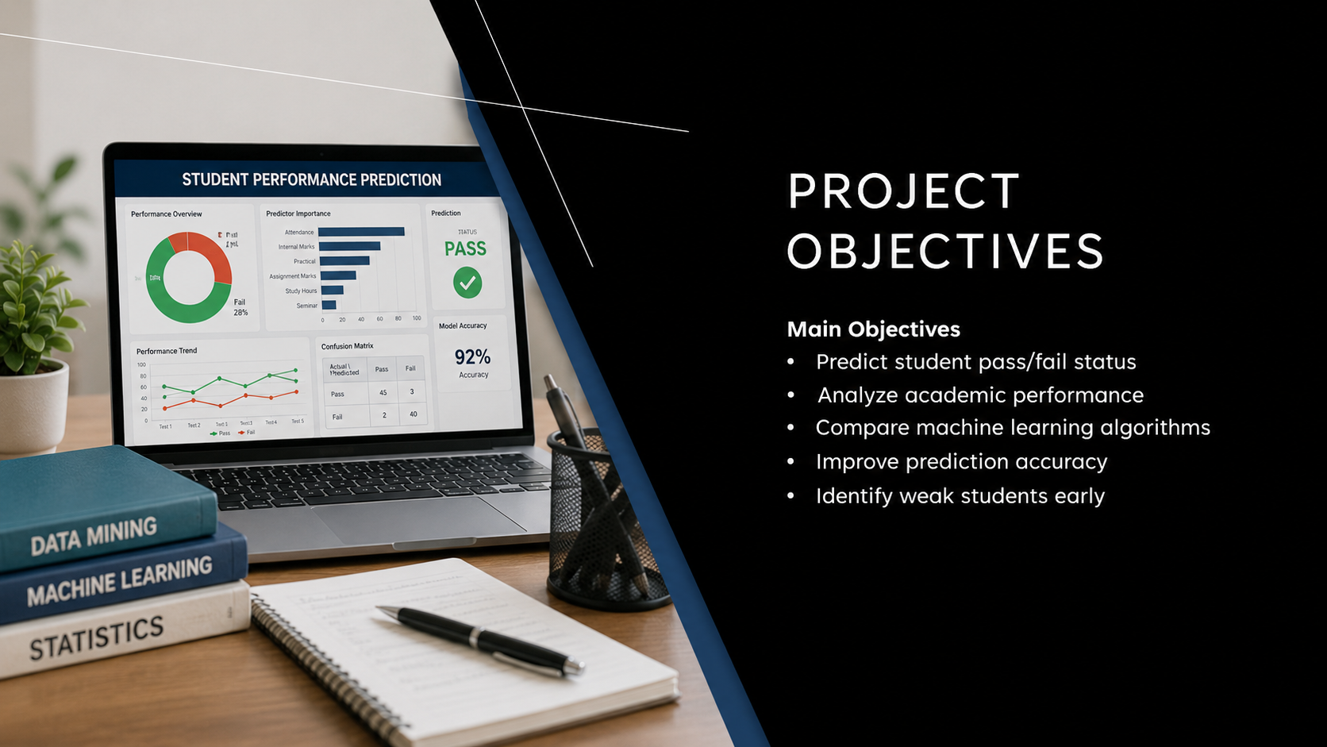
Project Objectives
Main Objectives
Predict student pass/fail status
Analyze academic performance
Compare machine learning algorithms
Improve prediction accuracy
Identify weak students early

Slide 5
Software and Tools Used
Tool | Purpose
IBM SPSS Modeler | Data Mining & Prediction
Microsoft Excel | Dataset Creation
CSV File | Data Storage

Slide 6
Future Enhancements
Future Scope
Use larger datasets
Add deep learning techniques
Develop web application
Real-time student monitoring
Cloud-based prediction system

Slide 7
Conclusion
Machine learning successfully predicts student performance.
Random Trees and Neural Networks gave high accuracy.
IBM SPSS Modeler provides efficient predictive analytics.
System helps institutions improve student success rates.

Slide 8
THANK YOU
for Your Attention !

